Slide 1
PROGRESS REPORT
Hanshvee Aditya Patil

Slide 2
Software Development Project
Definition: Boxers Community a Social Platform
Type: Web Development
Technology : MERN Stack

Slide 3
Purpose
To join the player who can’t find his/her trainner

Slide 4
TECHNOLOGY
Technical Problems That Have Been Solved
Dubious Technological Dependencies For Project
Outstanding Technical Issues That Need To Be Solved
User Engagement
Responsive Design
Performance Optimization
Third-Party APIs
Social Media Integration
Image/Video Processing Tools
Notification Services
Database Management System
Operational Protocols
Security Measures
User-Friendly Database
Compatibility Testing
Notification System

Slide 5
RESOURCES
Project Resources
https://in.linkedin.com
https://www.instagram.com
https://www.canva.com
https://app.diagrams.net
https://www.visual-paradigm.com

Slide 6
GOALS FOR NEXT REVIEW
Work done
SRS Document
Designing of Login/Sign up
Designing of Home page
Learning Technology
Next Review Date
Implementation of frontend

Slide 7
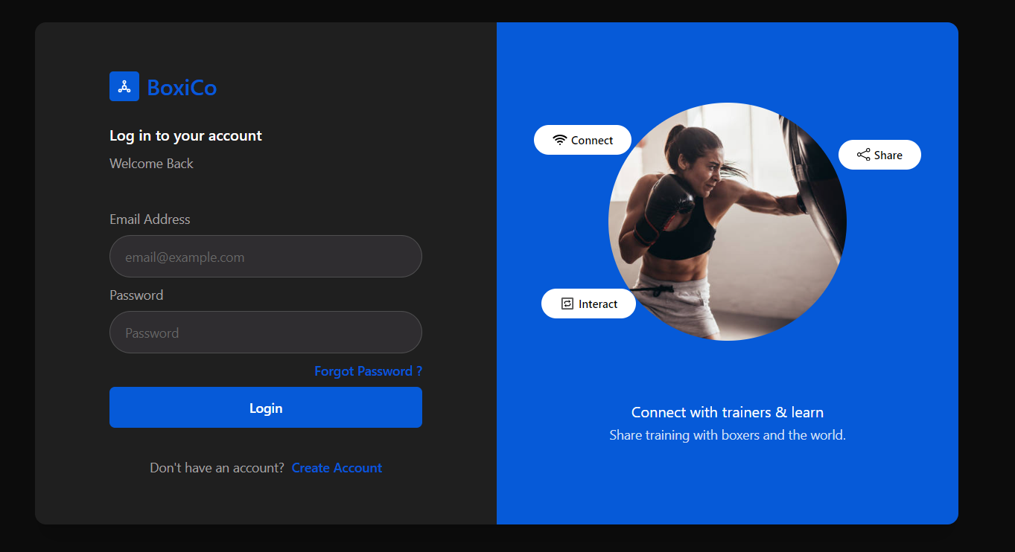
Designs

Slide 8
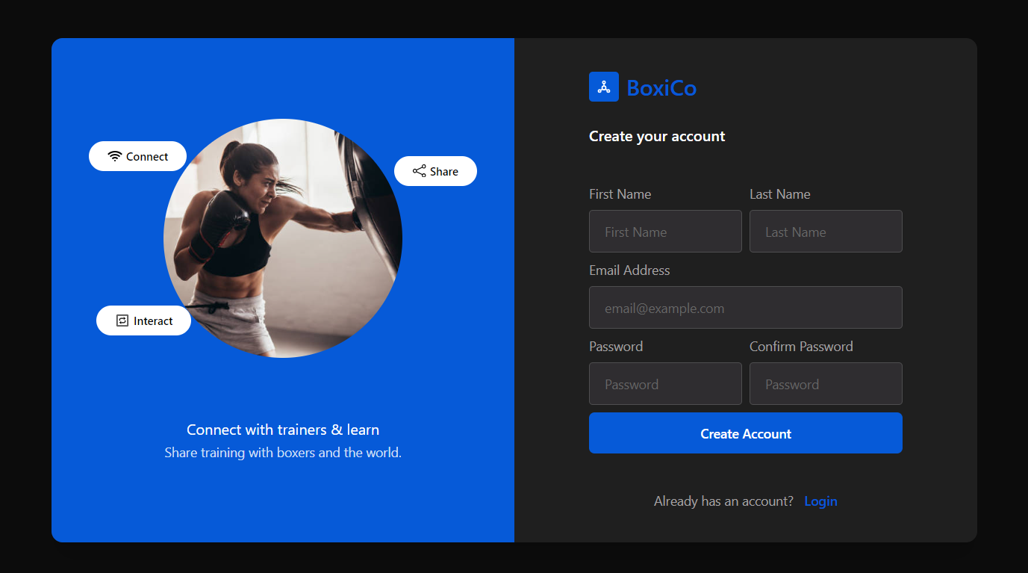
Designs

Slide 9
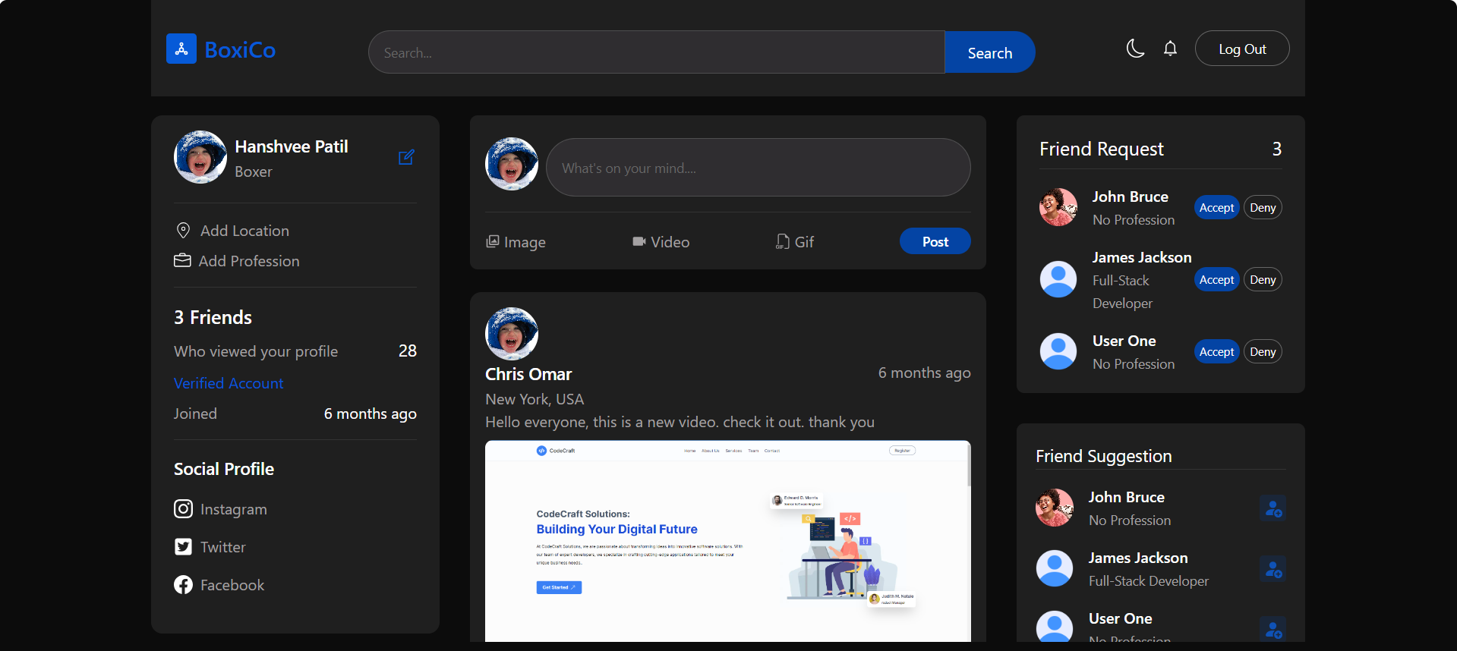
Designs

Slide 10
Thank You
Hanshvee Patil
IT-111
21ITUOS100
hanshpatil1982@gmail.com

